Slide 1
Data Types, Variables, and
Arrays

Slide 2
Java Is a Strongly Typed Language
Every variable has a type, every expression has a type, and every type is strictly defined
All assignments, whether explicit or via parameter passing in method calls, are checked for type compatibility
The Java compiler checks all expressions and parameters to ensure that the types are compatible

Slide 3
The Simple Types
Primitive types
Java defines eight simple (or elemental) types of data:
byte, short, int, long, char, float, double, and boolean
All have fixed size irrespective of platform unlike C/C++ to give portability
These can be put in 4 groups

Slide 4
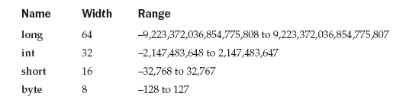
Integers
All are signed numbers. Java does not support unsigned,
positive only integers
Byte-working with streams and binary data
Declaration byte a,c;

Slide 5
class Light {
public static void main(String args[]) {
int lightspeed;
long days;
long seconds;
long distance;
// approximate speed of light in miles per second
lightspeed = 186000;
days = 1000; // specify number of days here
seconds = days * 24 * 60 * 60; // convert to seconds
distance = lightspeed * seconds; // compute distance
System.out.print("In " + days);
System.out.print(" days light will travel about ");
System.out.println(distance + " miles.");
}
}

Slide 6
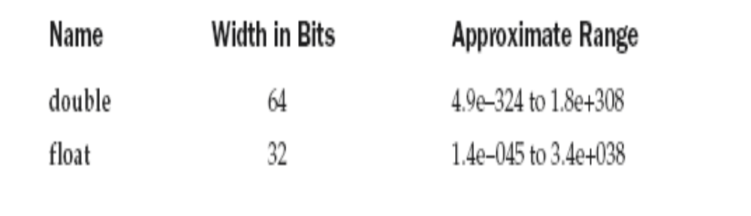
Floating-Point Types

Slide 7
class Area {
public static void main(String args[ ]) {
double pi, r, a;
r = 10.8; // radius of circle
pi = 3.1416; // pi, approximately
a = pi * r * r; // compute area
System.out.println("Area of circle is " + a);
}
}

Slide 8
Characters
char in Java is not the same as char in C or C++.
In C/C++, char is an integer type that is 8 bits wide
Instead, Java uses Unicode to represent characters
Unicode defines a fully international character set that can represent all of the characters found in all human languages (Latin, Greek, Arabic etc.)
ASCII character set occupies the first 127 values in UNICODE character set.

Slide 9
In Java char is a 16-bit type
The range of a char is 0 to 65,536
There are no negative chars

Slide 10
class CharDemo {
public static void main(String args[ ]) {
char ch1, ch2;
ch1 = 88; // code for X
ch2 = 'Y';
System.out.print("ch1 and ch2: ");
System.out.println(ch1 + " " + ch2);
}
}

Slide 11
class CharDemo2 {
public static void main(String args[ ]) {
char ch1;
ch1 = 'X';
System.out.println("ch1 contains " + ch1);
ch1++; // increment ch1
System.out.println("ch1 is now " + ch1);
}
}

Slide 12
Booleans
Can have only one of two possible values,
true or false
boolean flag;
flag=true;
If (1) // error because it requires boolean type expression
So it should be if (true) or if (flag)
System.out.print(10>3);// displays true

Slide 13
class BoolTest {
public static void main(String args[]) {
boolean b;
b = false;
System.out.println("b is " + b);
b = true;
System.out.println("b is " + b);
// a boolean value can control the if statement
if(b) System.out.println("This is executed.");
b = false;
if(b) System.out.println("This is not executed.");
// outcome of a relational operator is a boolean value
System.out.println("10 > 9 is " + (10 > 9));
}
}
The output generated by this program is shown here:
b is false
b is true
This is executed.
10 > 9 is true

Slide 14
Integer Literals – Decimal, Hexa and Octal
Floating-Point Literals
  For example, 2.0, 3.14159, and 0.6667 represent valid standard - notation floating-point numbers
  - Scientific notation uses a standard-notation, floating-point number plus a suffix that specifies a power of 10 by which the number is to be multiplied eg. 6.022E23, 314159E–05, and 2e+100

Slide 15
Boolean Literals – true , false
Character Literals
  Characters in Java are indices into the Unicode character set
  They are 16-bit values that can be converted into integers and manipulated with the integer operators, such as the addition and subtraction operators
  - A literal character is represented inside a pair of single quotes

Slide 16
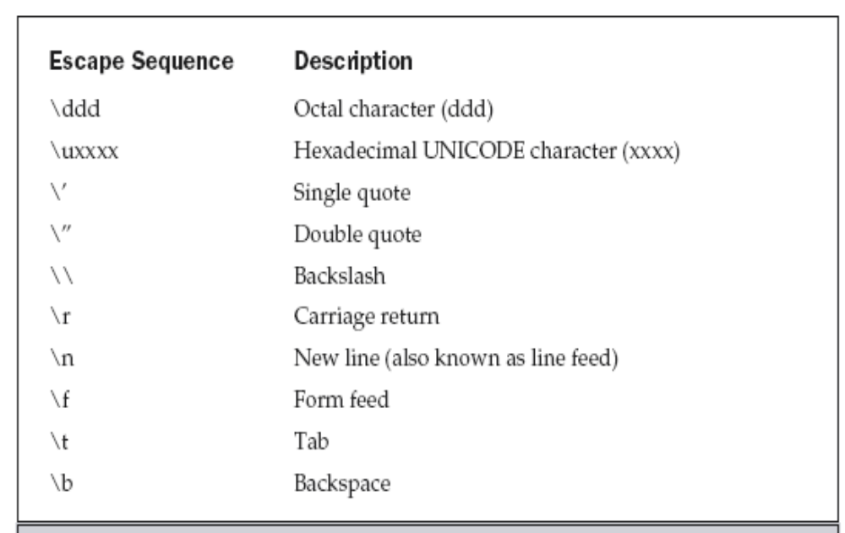

Slide 17
141 ₈ = (1*8² +4*8¹ + 1*8⁰⁾ ⁼ 97
\u0061 is ‘a’
public class sample {
public static void main(String[] args) {
System.out.println("\141");// displays a
System.out.println("\u0061");//displays a
}
}

Slide 18
String Literals
“Hello World”
“two\nlines”
“\”This is in double quotes\””

Slide 19
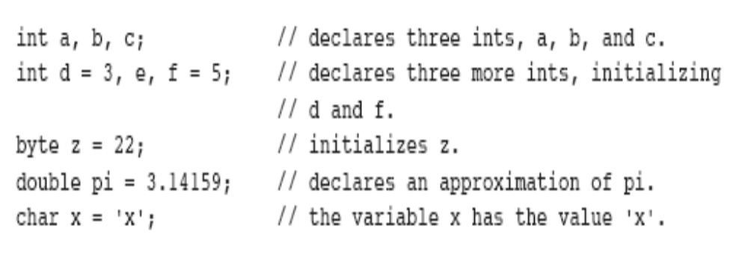
Declaring a Variable
type identifier [ = value][, identifier [= value] ...] ;

Slide 20
Dynamic Initialization
class DynInit {
public static void main(String args[]) {
double a = 3.0, b = 4.0;
// c is dynamically initialized
double c = Math.sqrt(a * a + b * b);
System.out.println("Hypotenuse is " + c);
}
}

Slide 21
The Scope and Lifetime of Variables
Java allows variables to be declared within any block
A block is begun with an opening curly brace and ended by a closing curly brace
A block defines a scope
A scope determines what objects are visible to other parts of your program

Slide 22
In Java, the two major scopes are those defined by a class and those defined by a method
As a general rule, variables declared inside a scope are not visible (that is, accessible) to code that is defined outside that scope
Scopes can be nested
Objects declared in the outer scope will be visible to code within the inner scope ; but reverse not true

Slide 23
class Scope {
public static void main (String args[])
{
int x; // known to all code within main
x = 10;
if(x == 10)
{ // start new scope
  int y = 20; // known only to this block
// x and y both known here.
System.out.println("x and y: " + x + " " + y);
x = y * 2;
}
// y = 100; // Error! y not known here
// x is still known here.
System.out.println("x is " + x);
}// main end
}//class end

Slide 24
class LifeTime {
public static void main(String args[]) {
int x;
for(x = 0; x < 3; x++) {
int y = -1; // y is initialized each time block is //entered
System.out.println("y is: " + y); // this always //prints -1
y = 100;
System.out.println("y is now: " + y);
}
}
}

Slide 25
class ScopeErr {
public static void main(String args[]) {
int bar = 1;
{ // creates a new scope
int bar = 2; // Compile-time error – bar //already defined!
}
}
}

Slide 26
Type Conversion and Casting
When one type of data is assigned to another type of variable, an automatic type conversion will take place if the following two conditions are met:
■ The two types are compatible.
■ The destination type is larger than the source type.
When above conditions are met widening conversion takes place

Slide 27
Example int a; byte b; a=b;
For widening conversion numeric types such as integer and floating point are compatible with each other.
But numeric types to char/boolean is not compatible.
Char and boolean are not compatible with each other.
Automatic type conversion is made when you are storing an integer constant into byte,short,long or char

Slide 28
Casting Incompatible Types
what if you want to assign an int value to a byte variable?
This conversion will not be performed automatically, because a byte is smaller than an int
narrowing conversion

Slide 29
(target-type) value
target-type specifies the desired type to convert the specified value to
    int a;
    byte b;
    // ...
    b = (byte) a;

Slide 30
int a; float b=1.23f;
a=b //truncation a will be 1.
When RHS is too large to fit in LHS type, the result=value%target type range.
Ex: byte b; int k=257; b=(byte)k;
b will be 257%256=1.

Slide 31
class Conversion {
public static void main(String args[]) {
byte b;
int i = 257;
double d = 323.142;
System.out.println("\nConversion of int to byte.");
b = (byte) i;
System.out.println("i and b " + i + " " + b);
System.out.println("\nConversion of double to int.");
i = (int) d;
System.out.println("d and i " + d + " " + i);
System.out.println("\nConversion of double to byte.");
b = (byte) d;
System.out.println("d and b " + d + " " + b);
}
}

Slide 32
Output:
Conversion of int to byte.
i and b 257 1
Conversion of double to int.
d and i 323.142 323
Conversion of double to byte.
d and b 323.142 67

Slide 33
Automatic Type Promotion in Expressions
Example:
    byte a = 40;
    byte b = 50;
    byte c = 100;
    int d = a * b / c;
Java automatically promotes each byte or short operand to int when evaluating an expression

Slide 34
Subexpression a * b is performed using integer
byte b = 50
b = b * 2
// error: Cannot assign an int to a byte
In this case we need to explicitly specify:
byte b = 50;
b = (byte) (b*2);

Slide 35
The Type Promotion Rules
All byte ,short and char values are promoted to int
If one operand is a long, the whole expression is promoted to long
If one operand is a float, the entire expression is promoted to float
If any of the operands is double, the result is double

Slide 36
class Promote {
public static void main(String args[ ]) {
byte b = 42;
char c = 'a';
short s = 1024;
int i = 50000;
float f = 5.67f;
double d = .1234;
double result = (f * b) + (i / c) - (d * s);
System.out.println((f * b) + " + " + (i / c) + " - " + (d * s));
System.out.println("result = " + result);
}
}

Slide 37
double result = (f * b) + (i / c) - (d * s);
In the first subexpression, f * b, b is promoted to a float and the result of the subexpression
is float
Next, in the subexpression i / c, c is promoted to int, and the result is of type int
In d * s, the value of s is promoted to double, and the type of the subexpression is double

Slide 38
The outcome of float plus an int is a float
Then the resultant float minus the last double is promoted to double, which is the type for the final result of the expression

Slide 39
Arrays
An array is a group of like-typed variables that are referred to by a common name
A specific element in an array is accessed by its index

Slide 40
One-Dimensional Arrays
type var-name[ ]; - No array exists only creates a variable of type array. The value of array variable is set to null.
array-var = new type[size]; - allocating memory
Example:
int month_days[] = new int[12]
All elements are initialized to 0.

Slide 41
Obtaining an array
Two steps
Declaration int a[];
Allocation a=new int[20];
Array elements can be accessed by using arrayname with index in [].
Index starts from 0

Slide 42
// Demonstrate a one-dimensional array.
class Array {
public static void main(String args[]) {
int month_days[];
month_days = new int[12];
month_days[0] = 31;
month_days[1] = 28;
month_days[2] = 31;
month_days[3] = 30;
month_days[4] = 31;
month_days[5] = 30;
month_days[6] = 31;
month_days[7] = 31;
month_days[8] = 30;
month_days[9] = 31;
month_days[10] = 30;
month_days[11] = 31;
System.out.println("April has " + month_days[3] + " days.");
}
}

Slide 43
Arrays can be initialized when they are declared
An array initializer is a list of comma-separated expressions surrounded by curly braces
There is no need to use new

Slide 44
class AutoArray {
public static void main(String args[ ]) {
int month_days[] = { 31, 28, 31, 30, 31, 30, 31, 31, 30, 31,30, 31 };
System.out.println("April has " + month_days[3] + " days.");
}
}

Slide 45
class Average {
public static void main(String args[]) {
double nums[] = {10.1, 11.2, 12.3, 13.4, 14.5};
double result = 0;
int i;
for(i=0; i<5; i++)
result = result + nums[i];
System.out.println("Average is " + result / 5);
}
}

Slide 46
Multidimensional Arrays
To declare a multidimensional array variable,
specify each additional index using another set of square brackets
Example:
int twoD[][] = new int[4][5];

Slide 47
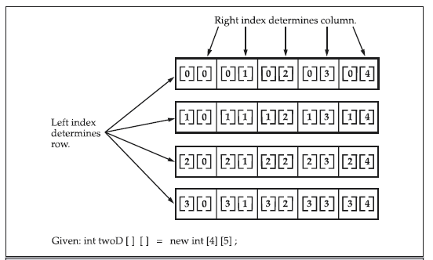

Slide 48
class TwoDArray {
public static void main(String args[]) {
int twoD[][]= new int[4][5];
int i, j, k = 0;
for(i=0; i<4; i++)
for(j=0; j<5; j++) {
twoD[i][j] = k;
k++;
}
for(i=0; i<4; i++) {
for(j=0; j<5; j++)
System.out.print(twoD[i][j] + " ");
System.out.println();
}
}
}
0 1 2 3 4
5 6 7 8 9
10 11 12 13 14
15 16 17 18 19

Slide 49
When you allocate memory for a multidimensional array, you need only specify the memory for the first (leftmost) dimension
You can allocate the remaining dimensions
separately
Example:
  int twoD[][] = new int[4][];
  twoD[0] = new int[5];
  twoD[1] = new int[5];
  twoD[2] = new int[5];
  twoD[3] = new int[5];

Slide 50
When you allocate dimensions manually, you do not need to allocate the same number of elements for each dimension
Since multidimensional arrays are actually arrays of arrays, the length of each array is under your control

Slide 51
class TwoDAgain {
public static void main(String args[]) {
int twoD[][] = new int[4][];
twoD[0] = new int[1];
twoD[1] = new int[2];
twoD[2] = new int[3];
twoD[3] = new int[4];
int i, j, k = 0;
for(i=0; i<4; i++)
for(j=0; j<i+1; j++) {
twoD[i][j] = k;
k++;
}
for(i=0; i<4; i++) {
for(j=0; j<i+1; j++)
System.out.print(twoD[i][j] + " ");
System.out.println();
} } }
0
1 2
3 4 5
6 7 8 9

Slide 52
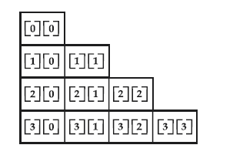

Slide 53
It is possible to initialize multidimensional arrays
You can use expressions as well as literal values inside of array initializers

Slide 54
class Matrix {
public static void main(String args[]) {
double m[ ][ ] = {
{ 0*0, 1*0, 2*0, 3*0 },
{ 0*1, 1*1, 2*1, 3*1 },
{ 0*2, 1*2, 2*2, 3*2 },
{ 0*3, 1*3, 2*3, 3*3 }
};
int i, j;
for(i=0; i<4; i++) {
for(j=0; j<4; j++)
System.out.print(m[i][j] + " ");
System.out.println();
}
}
}

Slide 55
Output:
  0.0 0.0 0.0 0.0
  0.0 1.0 2.0 3.0
  0.0 2.0 4.0 6.0
  0.0 3.0 6.0 9.0

Slide 56
Alternative Array Declaration Syntax
There is a second form that may be used to declare an array:
type[ ] var-name;
Example: These two are equivalent
int al[ ] = new int[3];
int[ ] a2 = new int[3];
The following declarations are also equivalent:
char twod1[ ][ ] = new char[3][4];
char[ ][ ] twod2 = new char[3][4];

Slide 57
Note:
Java does not support or allow pointers
Java cannot allow pointers, because doing so would allow Java applets to breach the firewall between the Java execution environment and the host computer
Java is designed in such a way that as long as you stay within the confines of the execution environment, you will never need to use a pointer, nor would there be any benefit in using one

